Slide 1
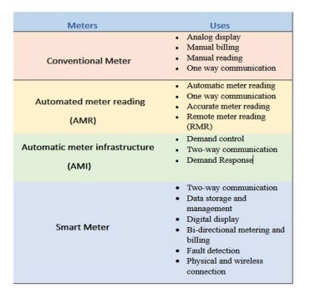
Evolution of electricity metering

Slide 2
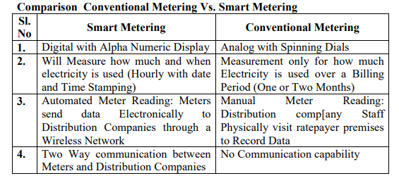

Slide 3
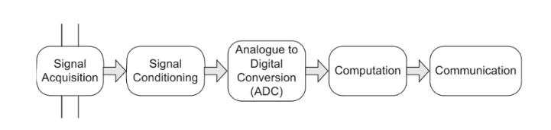
Smart meter
Smart meter is an electricity meter that has metering as well as communication abilities
It has two key functions to perform:
for providing data on energy usage to consumers to help control over consumption and cost
for sending data to the utility for peak-load requirements, load factor control and to develop pricing strategies on the basis of consumption information
Block diagram of Smart meter

Slide 4
Signal Acquisition
A core function of the smart meter is to acquire system parameters accurately and continuously for subsequent computation and communication.
The fundamental electrical parameters required are
magnitude and frequency of the voltage
magnitude and phase displacement (relative to the voltage) of current.
Other parameters such as the power factor, the active/reactive power, and Total Harmonic Distortion (THD) are computed using these fundamental quantities.
Current and voltage sensors measure the current into the load and the voltage at the point of supply
typically using a current-sensing shunt resistor on the current input channel and a resistive voltage divider on the voltage input channel

Slide 5
Signal Conditioning
The signal conditioning stage involves the preparation of the input signals for the next step in the process, ADC.
The signal conditioning stage may include addition/subtraction, attenuation/amplification and filtering such that its maximum magnitude lies within the limits of the inputs for the ADC stage.
Analogue to Digital Conversion
Current and voltage signals obtained from the sensors are first sampled and then digitised to be processed by the metering software.
The ADC converts analogue signals coming from the sensors into a digital form.
Since there are two signals (current and voltage) in a single phase meter, if a single ADC is used, a multiplexer is required to send the signals in turn to the ADC.

Slide 6
Computation
Computation requirements are split into arithmetic operations on input signals, time stamping of data, preparation of data for communication or output peripherals, handling of routines associated with irregular input , storage of data, system updates and coordinating different functions
Due to the relatively large number of arithmetic operations required for the derivation of the parameters, a Digital Signal Processor (DSP) is used.
For computation, volatile memory and non-volatile memory is needed.
Volatile memory is used for temporary storage of data to support the processor as operations are undertaken.
A certain amount of non-volatile memory is typically required to store specific information, such as the unit serial number and maintenance access key codes

Slide 7
Input/Output
A smart meter has a display that presents information in the form of text and graphs for the human user.
Liquid Crystal Displays (LCD) and the Light Emitting Diodes (LED) are preferred for their low cost and low power consumption requirements.
Smart meters provide a small key pad or touch screen for human-machine interaction
Some meters also provide remote calibration and control capability through communication links.
Energy consumption and tariffs may be displayed on a separate customer display unit located in an easily visible location within the residence
This is to encourage customers to reduce their energy use, either throughout the year or at times of peak demand when generation is short.

Slide 8
SMART METERING
A smart meter tracks the utility energy consumption that occurs on the system or outlet it is attached to. For example, a smart meter connected to a natural gas line tracks the number of therms consumed.
Smart metering is the main initiative for fulfilling the objectives of smart grid (SG).
Smart metering reduces the commercial losses, monitoring of energy (real time or near real time), energy theft detection, enhancement in grid reliability, and leads to better revenue as well as tariff management.
It introduces innovative tariff structures and dispatches accurate bills based on meter data, thus reducing the annoyance of customers and increasing the improvement of customer loyalty.
It will encourage consumers to change behavior and optimize energy consumption, even by generating electricity at their own premises and vend it back to the grid.

Slide 9
Basic Architecture of Smart Meter System
The smart meters collect data locally and transmit via a local area network to a data collector. The collector retrieves the data and may or may not carry out any processing of the data.
Data is transmitted via a wide area network (WAN) to the utility central collection point for processing and use by business applications.
Depending on the application, energy, gas, or water metering, one or more sensors may be interfaced to front end electronics, an energy source with the associated power management circuitry, a communication node, and a microcontroller for system management
There are three main areas of a smart meter design namely- the power system, microcontroller, and communications interface

Slide 10
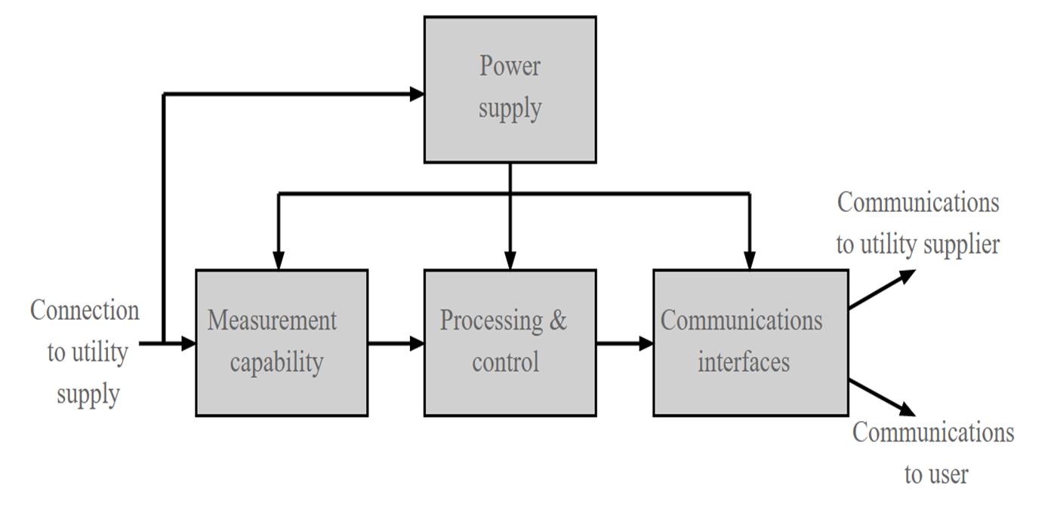


Slide 11
SMART METER SYSTEM
Smart metering in power grids requires specific hardware to support the functionality of the system. Here are some examples of hardware used in smart metering in power grids:
Smart Meters: As with smart metering in general, smart meters are a critical component of the hardware used in smart metering in power grids. These meters are installed at customers' premises to measure and monitor energy consumption.
Data Concentrators: Similar to smart metering in general, data concentrators are used in power grids to collect data from multiple smart meters and transmit it to a central data management system. This helps utilities to gather and analyze data on energy usage across the grid.

Slide 12
Communication Networks: Smart metering in power grids requires robust communication networks to support the transmission of data between devices and systems. These networks may use wired or wireless technologies, depending on the specific requirements of the system.
Substation Automation Systems: Substation automation systems are used to monitor and control the flow of electricity through the grid. They can provide real-time data on the performance of the grid, allowing utilities to identify and address issues quickly.

Slide 13
Distribution Management Systems: Distribution management systems are software systems that help utilities manage the distribution of electricity across the grid. They can optimize the flow of electricity to minimize losses and improve efficiency.
Advanced Metering Infrastructure (AMI) Systems: AMI systems are used in smart metering in power grids to provide a comprehensive view of energy consumption across the grid. These systems can collect data from a range of sources, including smart meters, substation automation systems, and other devices.
Intelligent Electronic Devices (IEDs): IEDs are used to monitor and control the performance of equipment in the grid, such as transformers and switches. They can provide real-time data on the condition of this equipment, allowing utilities to identify and address issues before they become serious.
Sensors: Smart metering systems may also use sensors to monitor environmental conditions, such as temperature and humidity, that can affect energy usage. These sensors can provide additional data to help utilities optimize energy efficiency.

Slide 14
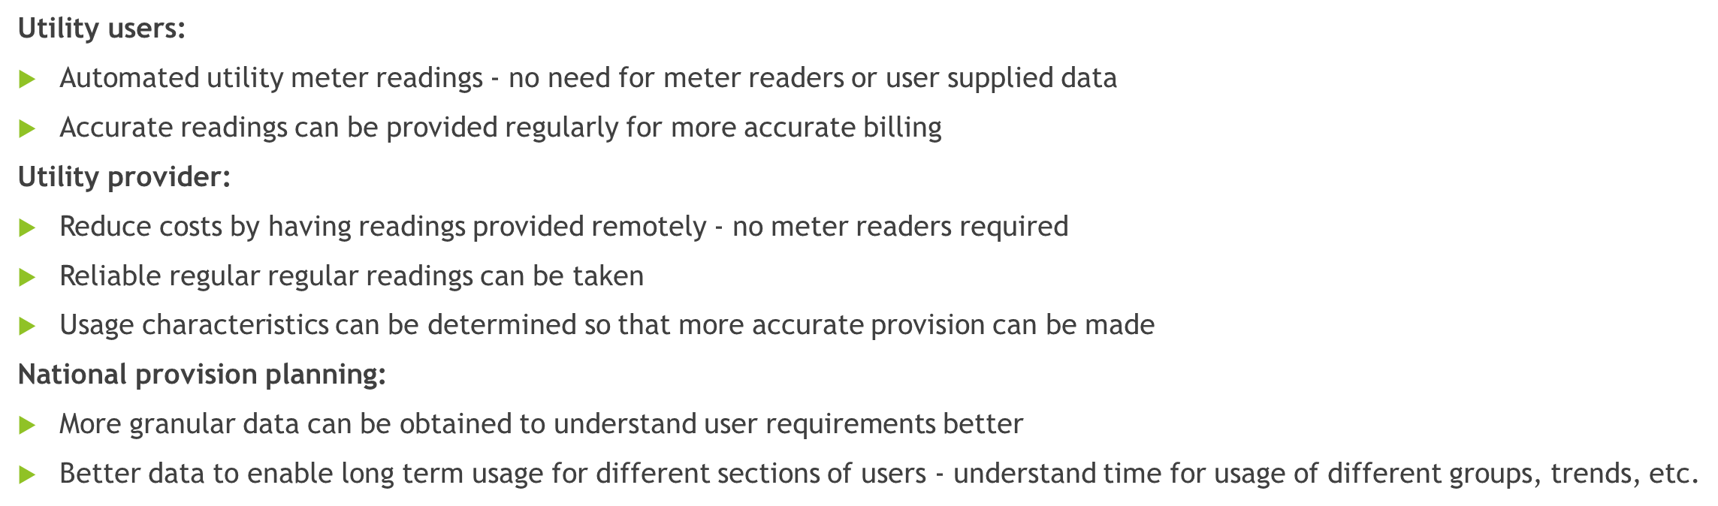
Smart meter benefits

Slide 15
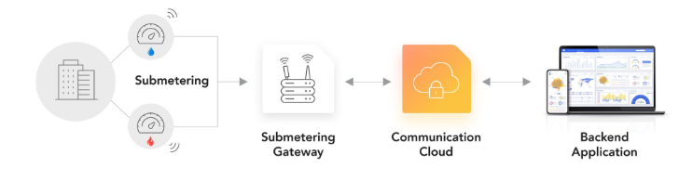
Smart metering protocols
Like all IoT devices, smart meters require a connection to a network.
Smart meters don’t always transmit directly to the cloud. They typically transmit data to a local smart meter gateway, which aggregates data from all meters in an area and then forwards it to the cloud, where providers and customers can access it through a platform

Slide 16
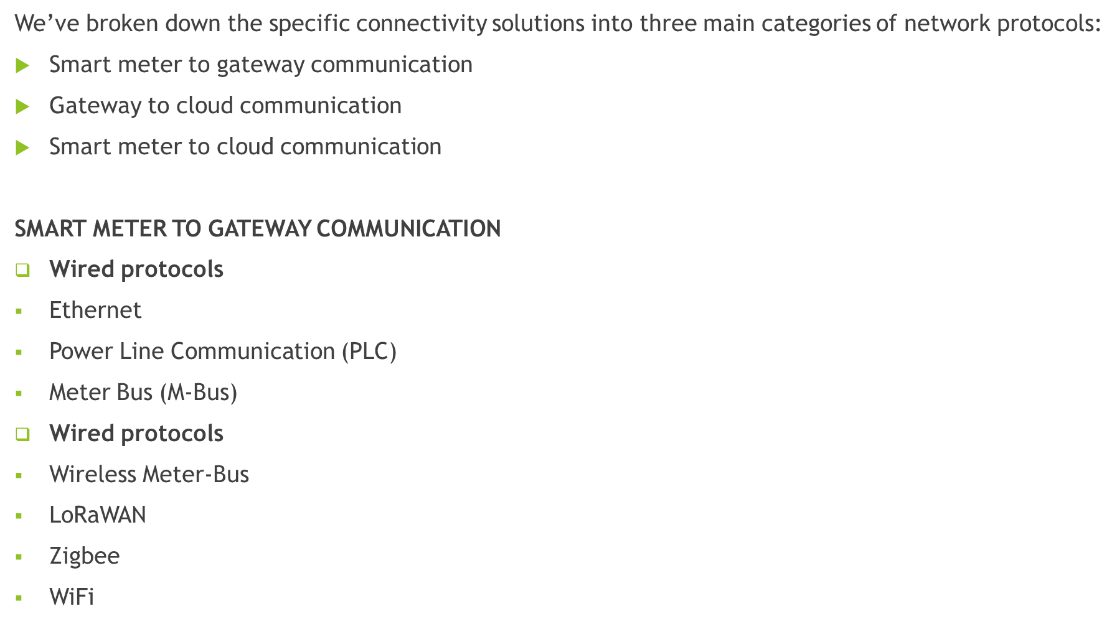

Slide 17
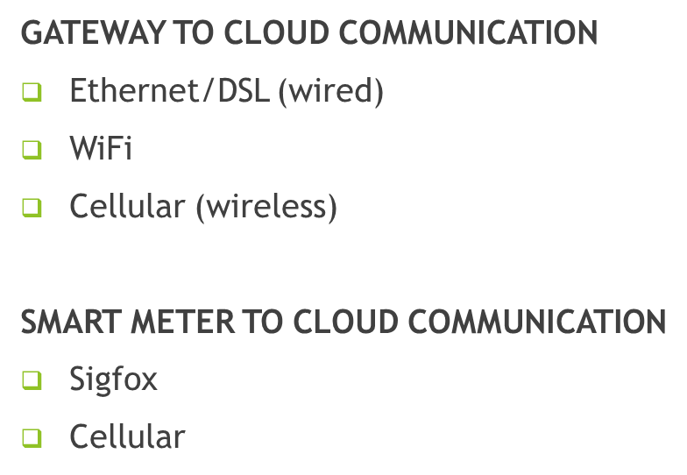
Smart metering protocols

Slide 18
Wired protocols
Smart metering protocols
Ethernet
Using ethernet connections, smart meters can use TCP/IP or UDP/IP to send data to the gateway.
Power Line Communication (PLC)
PLC is one of the simplest options for smart meter communication
Power lines weren’t built for data transmissions; they were built to provide electricity.
So when a smart meter communicates through a power line, these data signals often encounter interference from the electrical current running to powered devices.
PLC doesn’t require utility providers to install additional network infrastructure, but it’s less reliable than other solutions.
As with ethernet, PLC enables the meters to transmit to the gateway through TCP/IP.

Slide 19
Meter Bus (M-Bus)
M-Bus is a European standard that’s already widely used in buildings and was specifically developed for smart meters.
It includes physical, data, network, and application layers, but no transport, session, or presentation layers.
With M-Bus, smart meters need a gateway to convert the data to TCP/IP for transport to the cloud.
Wireless protocols
Wireless Meter-Bus (wM-Bus)
Wireless M-Bus is simply a wireless version of the M-Bus standard.
It’s already widely available in Europe
A Wireless M-Bus network is based on a star topology network with master and slave devices
operates on three different frequencies, depending on the mode a meter or gateway uses

Slide 20
LoRaWAN
LoRaWAN is a popular LPWAN solution with widely available networks in 25 countries.
Providers can connect to one of these networks or deploy their own.
Each LoRaWAN provider only covers a specific region, and there are no roaming agreements between Mobile Network Operators (MNOs).
This means that when you choose a service provider and deploy in a region they don’t serve, you have to either select an additional LoRaWAN service provider and manage multiple contracts or deploy your own gateway to connect to your current MNOs network.
MIOTY
MIOTY is a new LPWAN developed for large-scale industrial IoT applications.
MIOTY uses telegram splitting to divide data into subpackets, then transmits the packets at different times and frequencies, which helps to reduce interference.
The Mioty gateway then scans the spectrum for Mioty sub-packets and reassembles them into a complete message.

Slide 21
DATA PROTOCOLS
Smart meters don’t all use the same protocols to communicate, and the standards often vary by region. There are several protocols smart meter manufacturers should be familiar with, including:
DLMS/COSEM
ANSI C12.18
Open Smart Grid Protocol (OSGP)
TCP/IP
UDP/IP
MQTT
CoAP
HTTP
Websockets
XMPP

